Slide 2
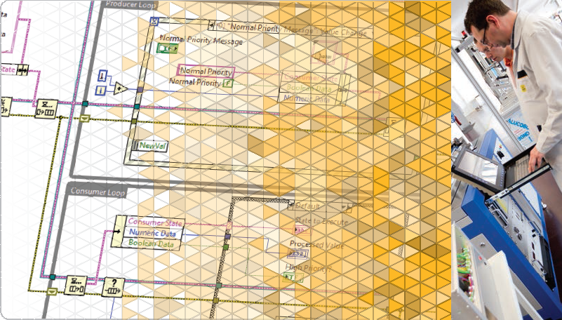
LabVIEW Core 2

Slide 3
Welcome to LabVIEW Core 2
Course Learning Map
Lesson 1
Implementing Design Patterns
Lesson 4
Lesson 2
Using Variables
Communicating Data Between Parallel Loops
Lesson 3
Controlling the User Interface
Lesson 5
Creating and Distributing Applications
Lesson 6
File I/O Techniques
Improving an Existing VI
Lesson 7

Slide 4
Lesson 4
Controlling the User Interface
Use property nodes, invoke nodes, and control references to programmatically control front panel objects.
VI Server Architecture
Property Nodes
Invoke Nodes
Control References

Slide 5
C. Invoke Nodes
Demonstrate how to use Invoke Nodes to perform actions on controls of VIs.
Definition
Control Methods
VI Methods

Slide 6
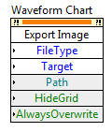
C. Invoke Nodes
Invoke Nodes
Invoke Nodes call methods or actions on objects.
Required Inputs
Optional Inputs

Slide 7
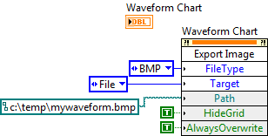
Create an Invoke Node
Create an Invoke Node for a front panel indicator.
Notes:
An example of a method that is common to all controls is the Reinitialize to Default method.
Both charts and graphs can export images.

Slide 8

C. Invoke Nodes
VI Methods
Class Name
Method Name
Parameter

Slide 9
Exercise 4-2
Customize the VI Window
Use Property Nodes and Invoke Nodes to affect the attributes of a VI.

Slide 10
Exercise 4-2
Customize the VI Window
What other front panel attributes and actions might you want to control programmatically from the block diagram?
Notes:
What other front panel or VI attributes and actions might you want to control programmatically from the block diagram?
Change the window title
Set the window size
Other discussion ideas:
Point out that we could have used the Export Data to Excel method in our Histogram exercise (producer/consumer exercise in last lesson) as a way of taking a Snapshot of data.

Slide 11
D. Control References
Practice creating control references and explain the difference between strictly typed and weakly typed control references.
Implicitly and Explicitly Linked Property Nodes
Creating Control References
Selecting the VI Server Class

Slide 12
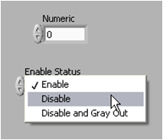

D. Control References
Implicitly and Explicitly Linked Property Nodes
Main VI
Main VI
SubVI
Implicitly Linked Property Node
Explicitly Linked Property Node

Slide 13
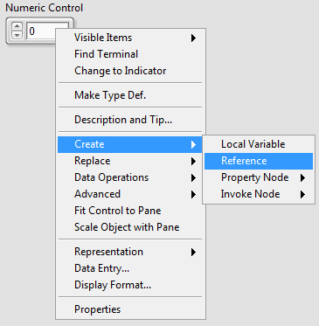


Creating Control References
Use control references to programmatically modify front panel objects from a subVI.

Slide 14
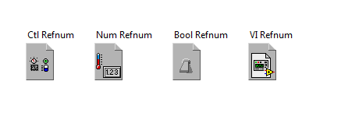
D. Control References
Selecting the VI Server Class
Notes:
The advantage of specifying a more generic class, such as specifying a Ctl Refnum instead of a Boolean Refnum, allows the subVI to accept a reference to any type of front panel control.
The disadvantage of specifying a more generic class is that it limits the properties available.
On the other hand, specifying a more specific class for the refnum makes the subVI more restrictive.
A mismatch of refnum types results in an edit-time error and the Run arrow will be broken.
In addition to specifying the class type, you can make the refnum strictly typed or weakly typed. Weakly typed control refnums are more flexible in the type of data they accept. For example, if the type of a weakly typed control reference is slide, you can wire a 32-bit integer slide, single-precision slide, or a cluster of 32-bit integer slides to the control reference terminal. If the type of a weakly typed control reference is control, you can wire a control reference of any type of control to the control reference terminal.

Slide 15
Exercise 4-3
Create SubVIs for Common Operations
Use control references to create a subVI that modifies VI properties.

Slide 16
Exercise 4-3
Create SubVIs for Common Operations
Several refnums are created but not closed in this exercise. Will this cause any problems?

Slide 17

Activity 4-1
Lesson Review
Refer to the participant guide to answer questions about what you have learned in this lesson and then discuss the answers as a group.

Slide 18
For each of the following items, determine whether they operate on a VI class or a Control class.
Format and Precision
Visible
Reinitialize to Default Value
Show Tool Bar

Slide 19
For each of the following items, determine whether they operate on a VI class or a Control class.
Format and Precision: Control
Visible: Control
Reinitialize to Default Value: Control
Show Tool Bar: VI

Slide 20

You have a Numeric control refnum in a subVI. Which control references could you wire to the control refnum terminal of the subVI?
Control reference of a knob
Control reference of a numeric array
Control reference of a thermometer indicator
Control reference of an LED
Notes:
Answer is a and c.

Slide 21
You have a Numeric control refnum in a subVI. Which control references could you wire to the control refnum terminal of the subVI?
Control reference of a knob
Control reference of a numeric array
Control reference of a thermometer indicator
Control reference of an LED
Notes:
Answer is a and c.

Slide 22
Lesson 5
File I/O Techniques
Create modular LabVIEW code that reads or writes measurement data stored in a file.
File Formats
Create File and Folder Paths
Write and Read Binary Files
Work with Multichannel Text Files with Headers
Access TDMS Files in LabVIEW and Excel

Slide 23
A. File Formats
Recognize appropriate use cases and the pros and cons of each file type.
Notes:
\

Slide 24

A. File Formats
Files store data as a series of bits.
Binary
TDMS
ASCII
Notes:
In LabVIEW, three of the most common techniques for storing data are:
ASCII file format
Direct binary storage
TDMS file format
Arrow size indicates increasing file size.

Slide 25
A. File Formats
Compare File Formats
 | ASCII | TDMS | Direct Binary
Numeric Precision | Good | Best | Best
Share data | Best (Any program easily) | Better (NI programs easily; Excel) | Good (only with detailed format information)
Efficiency | Good | Best | Best
Ideal Use | Share data with other programs when file space and numeric precision are not important. | Store measurement data and related metadata. High-speed streaming without loss of precision. | Store numeric data compactly with ability to random access .
Notes:
Use text format files for your data:
To make the data available to other users or applications.
If disk space and file I/O speed are not crucial.
If performing random access reads or writes is unnecessary.
If numeric precision is not important.
Use binary format files for your data:
When numeric precision is important.
When you need to randomly access stored data .
When efficiency is important.
A specific type of binary file, known as a Datalog file, is the easiest method for logging cluster data to a file.
Datalog files store arrays of clusters in a binary representation.
The storage format for Datalog files is complex, and therefore the data is difficult to access in any environment except LabVIEW.
Use TDMS files for the following purposes:
To store test or measurement data.
To create a structure for grouping your data.
To store information about your data.
To read and write data at high speeds.
TDMS file format:
Binary file (.tdms) that contains data and stores properties about the data.
Binary index file (.tdms_index) that provides consolidated information on all the attributes and pointers in the TDMS file.
TDMS file format is publicly documented.
Can use with TDM Excel Add-in Tool.

Slide 26
B. Creating File and Folder Paths
Programmatically create file and folder paths using LabVIEW VIs and tools.
Creation Methods
Creating Relative Paths and Folders
Dynamically Creating Filenames

Slide 27
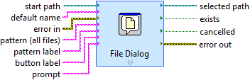
B. Creating File and Folder Paths
Methods of Creating File and Folder Paths
Hard-coded paths
File Dialog
Programmatic creation
Notes:
You have several option in selecting a method for creating filenames and destination directories.
Until now, we have used the File Dialog to specify a file name and location. However, it is often desirable to programmatically create folders and file paths.

Slide 28


Creating File and Folder Paths

Slide 29


B. Creating File and Folder Paths
Caveats of Programmatic Path Creation
Result depends on the calling VI.
If you have not saved the VI or project, returns <Not a Path>.
Only works on Windows-based systems.

Slide 30
Exercise 5-1
Create File and Folder Paths
Check the existence of a folder. If folder does not exist, create it.
Dynamically create filenames using time and date information.

Slide 31
Exercise 5-1
Create File and Folder Paths
How would you change this VI to work with other file formats?
Notes:
How would you change this VI to work with other file formats?
The Create Data File.vi in the exercise generated a filename with a *.txt extension. This technique can be used to generate a filename with other file extensions. Only the file extension needs to change.
This VI doesn’t specify the contents. Therefore, this technique can easily be used for other file types (xml, ini, etc.) and formats (binary, TDMS, etc.).

Slide 32
C. Write and Read Binary Files
Identify binary file I/O VIs and functions from the File I/O palette and identify the pros and cons of using them.
Using Binary File Functions
Demonstration

Slide 33
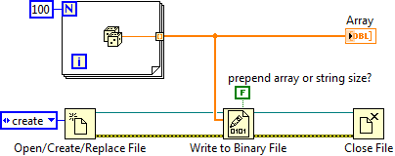
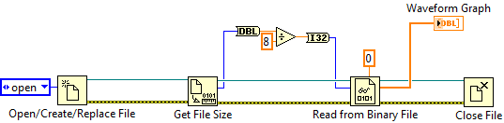
C. Write and Read Binary Files
Using Binary File Functions
Notes:
Binary files are given very limited coverage in the LabVIEW Core 2 course for the following reasons:
The use of binary files should only be considered after evaluating using text and TDMS files.
Compared to other formats, binary files are complex to work with, requiring an intimate knowledge of the file format.
Debugging code can add considerable time to the development cycle if things go wrong.
Developers should review the binary file examples that ship with LabVIEW, including DAQmx examples, for more information.
Discuss the above points and show students that the basic method of writing and reading binary files is the same as text files, except we don’t to convert the data to a string format.

Slide 34
Writing a Bitmap File
Use Binary File I/O to write a bitmap format file.
Notes:
<exercises>\Demonstrations\Bitmap File Writer
This demo achieves two goals; it shows students the flexibility of binary files, and the complexity of creating the data. If you don’t understand the data format it is impossible to access the information. TDMS is a better solution if you need the speed of binary and want to save test and measurement data.
This is a also good example of the Event Driven User Interface design pattern for the drawing VI.
Show the demo and move onto text files with headers.

Slide 35
D. Work with Multichannel Text Files with Headers
Programmatically create and manipulate header information and data stored in text files.
Add Headers to the File
Write Multichannel Data
Read Data and Extract Information

Slide 36
D. Work with Multichannel Text Files with Headers
Creating Text Files with Headers
No Header Data
Header Data
24.45 |  | 34.54
23.41 |  | 35.32
22.97 |  | 35.98
21.56 |  | 36.76
Operator Name |  | David
UUT S/N |  | A1234
Test Name |  | Pressure
Channel Name |  | Temperature |  | Pressure
Units |  | Kelvin |  | PSI
Max. Value |  | 24.45 |  | 36.76
 |  | 24.45 |  | 34.54
 |  | 23.41 |  | 35.32
 |  | 22.97 |  | 35.98
 |  | 21.56 |  | 36.76
Tab
End of Line
Notes:
Headers aid the understanding of data in the text file.
Explain how the tabs (or commas) are used to create columns and the carriage return/line feed (CR/LF) creates rows.
The creation of headers in text files can become cumbersome, especially if we want to create generic modules for creating the data.
TDMS files may be a better solution for creating files with complex/dynamic headers and students need to understand the benefits of using them.
For example, if data is being collected over a long period of time and we want to create entries for the maximum values measured, do we save all the data in memory, calculate the maximum value and write it to file?
Another option would be to write the data to a file, calculate the maximum value once the test is finished and create another file that includes the values.
A TDMS file allows the developer to write data and modify the properties (headers) at any time. NI has done all the hard work of keeping track of the header location in the file.

Slide 37
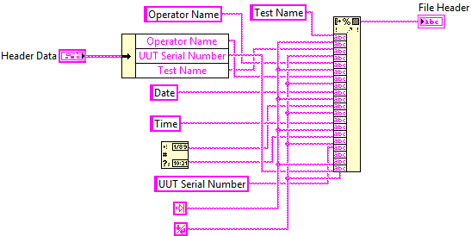
D. Work with Multichannel Text Files with Headers
Creating Text Files with Headers—Hard Coding
Notes:
New LabVIEW developers typically write code as shown in the screenshot, using a Format Into String function to create a tab delimited line of text.
This method can make it difficult to debug and modify the code for complex strings.
In addition, adding new strings to the header requires a lot of work. In other words, the code is not very scalable.
A modular approach is more scalable and easier to manage.

Slide 38
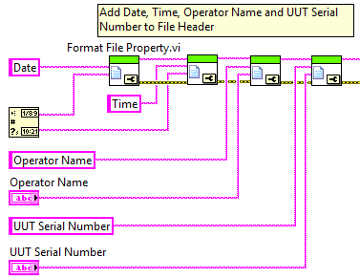
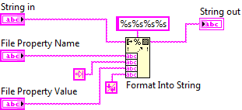
D. Work with Multichannel Text Files with Headers
Creating Text Files with Headers—SubVIs
Notes:
The use of a subVI to add data to the string and include the column separator (tab or comma) makes the diagram a lot easier to read.
If the column separator does need to be changed, only one VI has to be modified.
The class will see this code in an exercise.

Slide 39
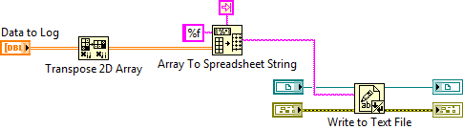
D. Work with Multichannel Text Files with Headers
Writing Multiple Channels

Slide 40
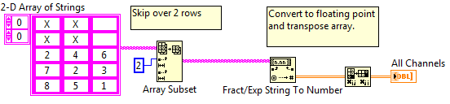
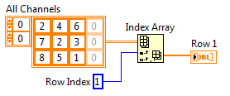
D. Work with Multichannel Text Files with Headers
Reading Channel Data

Slide 41
Exercise 5-2
Write Multiple Channels with Simple Header
Create ASCII file headers using a modular design.
Notes:
There are challenge exercises. Encourage faster students to complete one or both of the challenge exercises.

Slide 42
Exercise 5-2
Write Multiple Channels with Simple Header
When reading the data back into LabVIEW, what function did you use to skip over the header information?
Notes:
When reading the data back into LabVIEW, what function did you use to skip over the header information?
Array Subset. This function returns a portion of an array. For a 2D array, the function displays the index inputs for a row and a column. We used a row index of 4 to skip over the first 4 rows of header information (date, time, operator, and UUT serial).

Slide 43
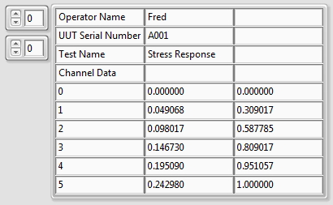
Activity 5-1
Read Data and Extract Information
After reading a spreadsheet file, how do you extract information?
How do you find a property value?
How do you read the UUT Serial Number value?
How do you extract channel data for column 1?

Slide 44
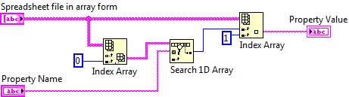
D. Work with Multichannel Text Files with Headers
Given a Property Name, Find the Value
Notes:
What should you do if Property Name is not found?
If the Search 1D Array function fails to find a match, the function returns a value of –1. To avoid unexpected errors in your application, you should check for the value of –1 before proceeding with your code. In this case, you might want to force an error if the Search 1D Array function returns a –1.

Slide 45
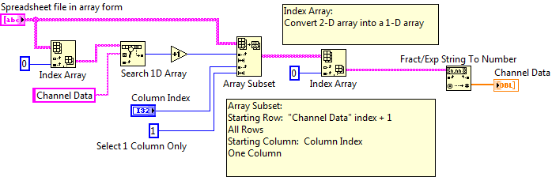
D. Work with Multichannel Text Files with Headers
Extracting a Data Channel

Slide 46
E. Access TDMS Files in LabVIEW and Excel
Identify TDMS file I/O VIs and functions from the File I/O palette and identify the pros and cons of using them.
TDMS File Format
Data Hierarchy and Properties
TDMS Functions
File Viewer

Slide 47

E. Access TDMS Files in LabVIEW and Excel
TDMS File Format
Properties
Raw data
Attributes
Pointers to data
.tdms
.tdms_index

Slide 48

E. TDMS Files—Data Hierarchy and Properties
TDMS Files—Data Hierarchy and Properties
Data Set (File)
Description
Title
Author
…etc.
Property 1
Property n
Channel Group(s)
UUT
Procedure
Test Fixture
…etc.
Property 1
Property 2
Property n
Name
Comment
Unit
Sensor Info
…etc.
Channel(s)
Property 1
Property n
Notes:
With TDMS managing data and properties is much easier than ASCII file formats because TDMS has an API specifically designed to handle these various properties.

Slide 49
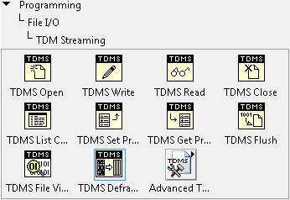


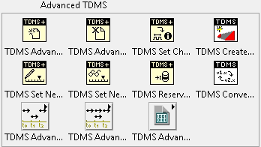
E. TDMS Files—Data Hierarchy and Properties
494949
TDMS Functions

Slide 50
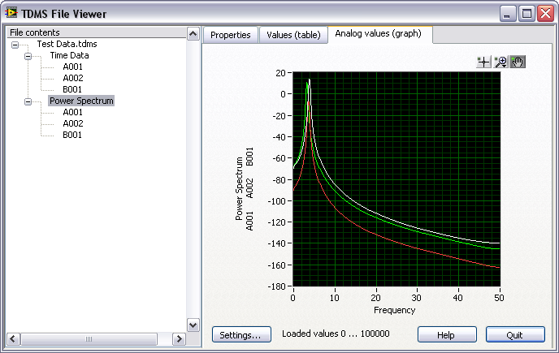

E. TDMS Files—Data Hierarchy and Properties
TDMS Files—File Viewer

Slide 51
Exercise 5-3
Write and Read TDMS Files
Learn how to write and read data from a TDMS file.

Slide 52
Exercise 5-3
Write and Read TDMS Files
What is the purpose of the Time Stamp constant and the Empty String constant in the TDMS Reader.vi?
Did the TDMS Read function read all the data in the TDMS file?
Why would it be difficult to implement the logger and reader using ASCII files? Custom Binary files?
Notes:
What is the purpose of the Time Stamp constant and the Empty String constant in the TDMS Reader.vi?
These constants define the data type of the properties being read from the TDMS file. Wire these inputs before wiring the property value output.
Did the TDMS Read function read all the data in the TDMS file?
No. We read a subset of the data based on the Data Set value (Time Data or Power Spectrum) and Serial Number. In the last text file example, we read in all the data and then used array functions to extract subsets of the data. With TDMS, this is handled automatically as part of the TDMS Read operation.
Why would it be difficult to implement the logger and reader using ASCII files? Custom Binary files?
To implement this in ASCII or Binary would require considerable amount of organization, either within one file or split into separate files. For example, one approach would be to separate the data into separate files with UUT and other property information embedded into the filename. E.g., “JohnSmith_Jun25_2009_UUT_A001” This would make your disk organization more complex but simplify the data reader and writer.
When you consider alternatives, it is easy to see the value of the TDMS file format!

Slide 53
Activity 5-2
Lesson Review
Refer to the participant guide to answer questions about what you have learned in this lesson and then discuss the answers as a group.

Slide 54
Consider the following code. The resulting Log File Path contains a text file path in which folder?
Same folder as VI that executed the code.
Same folder as the LabVIEW project.
Current user’s AppData directory.
Unknown
Notes:
Answer is b.

Slide 55
Consider the following code. The resulting Log File Path contains a text file path in which folder?
Same folder as VI that executed the code
Same folder as the LabVIEW project
Current user’s AppData directory
Unknown

Slide 56
What index value is returned from Search 1D Array function if Property Name is not found in the input array?
NaN (Not a Number)
0
-1
Negative Infinity
Notes:
Answer is c.

Slide 57
What index value is returned from Search 1D Array function if Property Name is not found in the input array?
NaN (Not a Number)
0
-1
Negative Infinity
Notes:
Answer: -1.
If the Search 1D Array doesn’t find a match, the function returns a value of -1. Typically you would want to check for a -1 condition before passing the value on for further processing. Maybe conditionally call the Index Array function in a Case structure if the Search 1D Array returns a -1.

Slide 58
You need to store data that other engineers will later analyze with Microsoft Excel. Which file storage format(s) should you use?
Tab-delimited ASCII
Custom binary format
TDMS
Notes:
Answer is a and c.

Slide 59
You need to store data that other engineers will later analyze with Microsoft Excel. Which file storage format(s) should you use?
Tab-delimited ASCII
Custom binary format
TDMS

Slide 60
TDMS files store properties at which of the following levels?
File
Channel Group
Channel
Value
Notes:
Answer is a, b, and c.

Slide 61
TDMS files store properties at which of the following levels?
File
Channel Group
Channel
Value

